Slide 1
Queue Implementation Issues
What do we need to implement a queue?
A data structure (container) to hold the data elements
Something to indicate the front of the queue
Something to indicate the end of the queue

Slide 2
Linked Implementation of a Queue
A queue q containing four elements
rear
q
front
4
count

Slide 3
Discussion
What if the queue is empty?
What if there is only 1 element?
Notes:
queue is empty: count =0, front=rear=null
only 1 element: front = rear

Slide 4
Linked List Queue
b
c
d
e
f
front
back
enqueue(x) {
back.next = new Node(x);
back = back.next;
}
// Basic idea only!

Slide 5
Queue After Adding Green Element
New element is added in a node at the end of the list, rear points to the new node, and count is incremented
rear
q
front
5
count

Slide 6
Linked List Queue
b
c
d
e
f
front
back
dequeue() {
x = front.item;
front = front.next;
return x;
}
// Basic idea only!

Slide 7
Queue After a dequeue Operation
Node containing yellow is removed from the front of the list (see previous slide), front now points to the node that was formerly second, and count has been decremented.
rear
q
front
4
count

Slide 8
Java Implementation
The queue is represented as a linked list of nodes:
We will again use the LinearNode class
front is a reference to the head of the queue (beginning of the linked list)
rear is a reference to the tail of the queue (end of the linked list)
The integer count is the number of nodes in the queue

Slide 9
public class LinkedQueue<T> implements QueueADT<T> {
/**
* Attributes
*/
private int count;
private LinearNode<T> front, rear;
/**
* Creates an empty queue.
*/
public LinkedQueue() {
count = 0;
front = rear = null;
}

Slide 10
//-----------------------------------------------------------------
// Adds the specified element to the rear of the queue.
//-----------------------------------------------------------------
public void enqueue (T element) {
LinearNode<T> node = new LinearNode<T> (element);
if (isEmpty( ))
front = node;
else
rear.setNext (node);
rear = node;
count++;
}

Slide 11
//-----------------------------------------------------------------
// Removes the element at the front of the queue and returns a
// reference to it. Throws an EmptyCollectionException if the
// queue is empty.
//-----------------------------------------------------------------
public T dequeue ( ) throws EmptyCollectionException {
if (isEmpty( ))
throw new EmptyCollectionException ("queue");
T result = front.getElement( );
front = front.getNext( );
count--;
if (isEmpty( ))
rear = null;
return result;
}

Slide 12
Array Implementation of a Queue
First Approach:
Use an array in which index 0 represents one end of the queue (the front)
Integer value count represents the number of elements in the array (so the element at the rear of the queue is in position count - 1)
Discussion: What is the challenge with this approach?

Slide 13
An Array Implementation of a Queue
A queue aq containing four elements
0
1
2
3
4
…
queue
aq
0
front
3
back
4
count

Slide 14
Queue After Adding a Green Element
The element is added at the array location given by the value of count and then count is increased by 1.
0
1
2
3
4
…
queue
aq
0
front
4
back
5
count

Slide 15
Queue After Removing an Element
The yellow element is removed from array location 0, remaining elements are shifted forward one position in the array, and then count is decremented.
0
1
2
3
4
…
queue
aq
0
front
3
back
4
count

Slide 16
public class ArrayQueue<T> implements QueueADT<T> {
private final int DEFAULT_CAPACITY = 100;
private int count;
private T[] queue;
public ArrayQueue() {
count = 0;
queue = (T[])(new Object[DEFAULT_CAPACITY]);
}
public ArrayQueue (int initialCapacity) {
count = 0;
queue = (T[])(new Object[initialCapacity]);
}

Slide 17
//-----------------------------------------------------------------
// Adds the specified element to the rear of the queue,
// expanding the capacity of the queue array if
// necessary.
//-----------------------------------------------------------------
public void enqueue (T element) {
if (size() == queue.length)
expandCapacity( );
queue[count] = element;
count++;
}

Slide 18
//-----------------------------------------------------------------
// Removes the element at the front of the queue and returns
// a reference to it. Throws anEmptyCollectionException if the
// queue is empty.
//-----------------------------------------------------------------
public T dequeue ( ) throws EmptyCollectionException {
if (isEmpty( ))
throw new EmptyCollectionException (“Empty queue");
T result = queue[0];
count--;
// shift the elements
for (int i = 0; i < count; i++)
queue[i] = queue[i+1];
queue[count] = null;
return result;
}

Slide 19
Second Approach: Queue as a Circular Array
Use a circular array to insert and remove items from a queue in constant time.
The idea is that the end of the array “wraps around” to the start of the array.
7
0
6
1
5
2
4
3
If we don't fix one end of the queue at index 0, we won't have to shift elements
Q:
0
size - 1
b
c
d
e
f
front
back
Notes:
The last index is thought to “precede” index 0
In an array whose last index is n, the location “before” index 0 is index n; the location “after” index n is index 0

Slide 20
Conceptual Example of a Circular Queue
front
After 5 dequeues
1
After 7 enqueues
1
0
0
front
12
12
11
11
rear
rear
10
10
rear
1
0
front
12
11
After 8 more enqueues
10

Slide 21
Circular Array Implementation of a Queue
3
2
3
1
4
front
queue
5
cq
0
8
5
n-1
6
rear
count
n-2
7
n-3
8
.
9
.
.
10

Slide 22
A Queue Straddling the End of a Circular Array
98
2
3
1
4
front
queue
5
cq
0
2
4
99
6
rear
count
98
7
97
8
.
9
.
.
10

Slide 23
Circular Queue Drawn Linearly
Queue from previous slide
98
cq
front
queue
0
1
2
3
4
…
96
97
98
99
2
4
rear
count

Slide 24
Enquing an item
Increment the value of rear
But it must take into account the need to loop back to index 0:
rear = (rear+1) % queue.length;
Can this array implementation also reach capacity?
Notes:
Yes, so it may need enlarging

Slide 25
Example: array of length 4 What happens?
0
1
2
3
2
front
queue
cq
Suppose we try to add one more item to a queue implemented by an array of length 4
1
3
rear
count
0
1
2
3
2
The queue is now full. How can you tell?
front
queue
cq
2
4
rear
count

Slide 26
Circular Array Queue
Q:
0
size - 1
b
c
d
e
f
front
back
enqueue(x) {
Q[back] = x;
back = (back + 1) % size
}
// Basic idea only!

Slide 27
Add another item! Need to expand capacity…
0
1
2
3
We can’t just double the size of the array and copy values to the same positions as before: circular properties of the queue will be lost
2
front
queue
cq
2
4
rear
count
0
1
2
3
4
5
6
7
2
front
queue
cq
2
4
These locations should be in use
rear
count

Slide 28
We could build the new array, and copy the queue elements into contiguous locations beginning at location front:
0
1
2
3
4
5
6
7
2
front
queue
cq
6
4
rear
count

Slide 29
Better: copy the queue elements in order to the beginning of the new array
0
1
2
3
4
5
6
7
0
front
queue
cq
4
4
rear
count

Slide 30
New element is added at rear = (rear+1) % queue.length
See expandCapacity() in CircularArrayQueue.java
0
1
2
3
4
5
6
7
0
front
queue
cq
5
5
rear
count

Slide 31
Circular Array Queue
Q:
0
size - 1
b
c
d
e
f
front
back
dequeue() {
x = Q[front];
front = (front + 1) % size;
return x;
}
// Basic idea only!

Slide 32
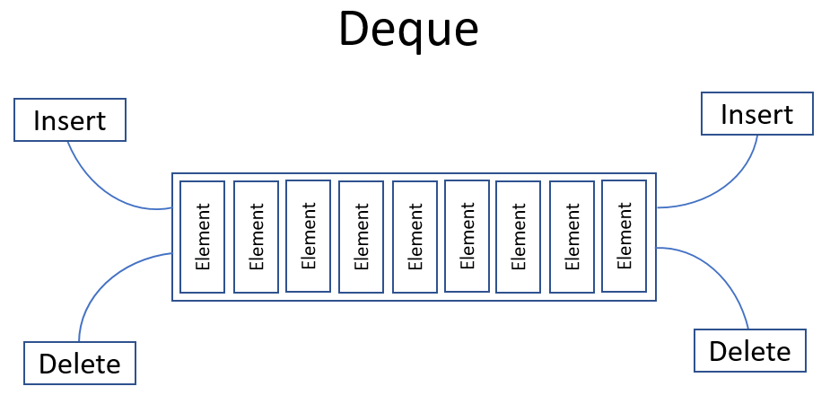
pronounced “deck”
Java’s Deque Implementations
ArrayDeque (a circular array)
LinkedList

Slide 33
Circular Array vs. Linked List
ArrayDeque | LinkedList
No capacity restrictions
Can only be used as a queue | Can be used as a queue or a list
Can’t access k^{th} element* | Can access k^{th} element
No values can be null | Allows storing null values
Faster ops at ends | Faster ops in the middle
Faster iteration | Slower iteration
May use unneeded space | Always just enough space
No extra space per element | Stores element and links to neighbors
Notes:
O(1) to access k^{th} element with circular arrays that allow it
O(N) to access k^{th} element with linked lists

